Slide 1



THE PROXY DESIGN PATTERN
STRUCTURAL DESIGN PATTERN IN JAVA

Slide 2
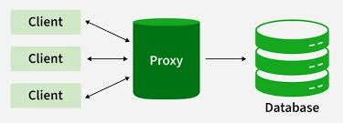
WHAT IS PROXY DESIGN PATTERN
structural design pattern that provides an intermediary for accessing a real object. The proxy object controls the access to the real object, adding an additional layer of functionality, such as logging, caching, or access control

Slide 3
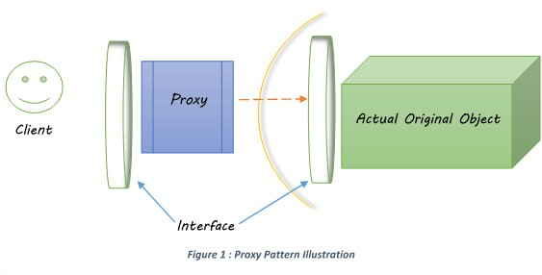
WHAT IS THE INTENT?
Definition: To provide a surrogate or placeholder for another object to control access to it.
The Goal: The Proxy acts as a "Gatekeeper" or "Agent" for the Real Object.
Transparency: The Client interacts with the Proxy as if it were the Real Object, using the same interface.

Slide 4

THE REAL-WORLD ANALOGY
The "Credit Card" Analogy
Real Subject: The actual Cash in your bank vault. (Heavy/Protected)
Proxy: The Plastic Credit Card. (Lightweight/Access Control)
How it works: You don't carry $5,000 in cash to the store. You carry the Card. The store "talks" to the Card, and the Card authorizes the bank to release the funds.

Slide 5
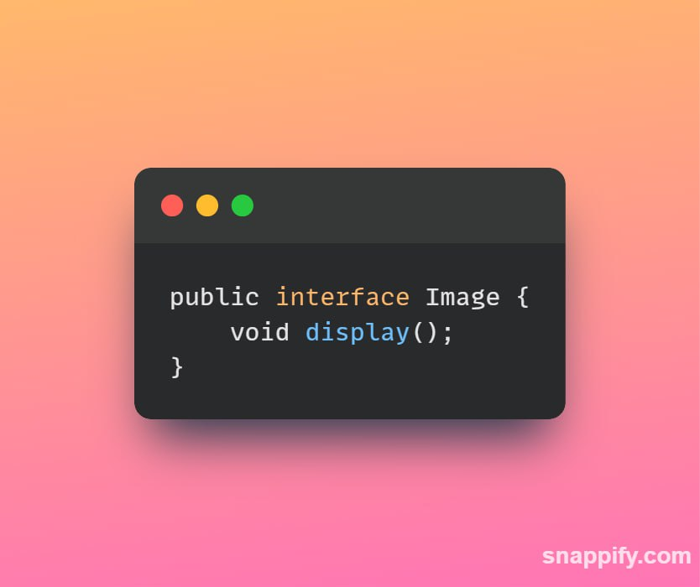
KEY PARTICIPANTS / COMPONENTS
Subject: The Subject is an interface or an abstract class that defines the common interface shared by the RealSubject and Proxy classes. It declares the methods that the Proxy uses to control access to the RealSubject.
Declares the common interface for both RealSubject and Proxy.
Usually includes the methods that the client code can invoke on the RealSubject and the Proxy.

Slide 6
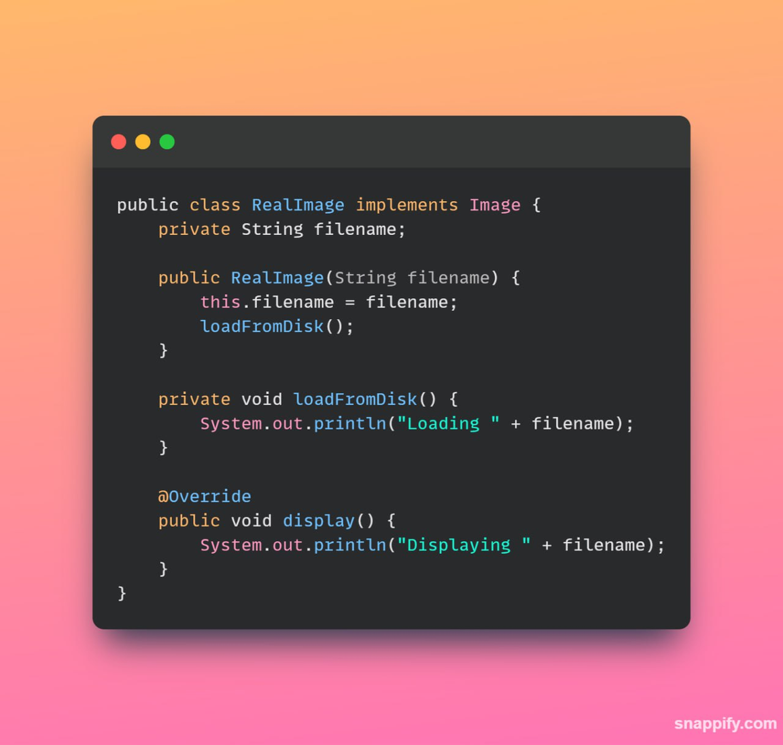
KEY PARTICIPANTS / COMPONENTS
RealSubject: is the actual object that the Proxy represents. It contains the real implementation of the business logic or the resource that the client code wants to access.
It Implements the operations declared by the Subject interface.
Represents the real resource or object that the Proxy controls access to.

Slide 7
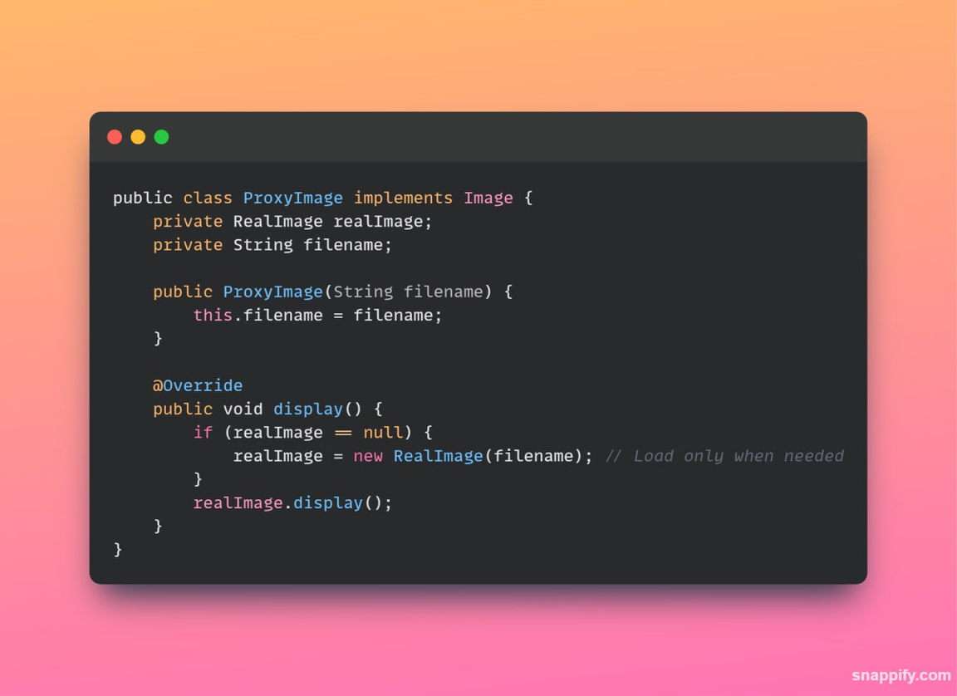
KEY PARTICIPANTS / COMPONENTS
Proxy: The Proxy acts as a surrogate or placeholder for the RealSubject. It controls access to the real object and may provide additional functionality such as lazy loading, access control, or logging.
Implements the same interface as the RealSubject (Subject).
Maintains a reference to the RealSubject.
Controls access to the RealSubject, adding additional logic if necessary.

Slide 8
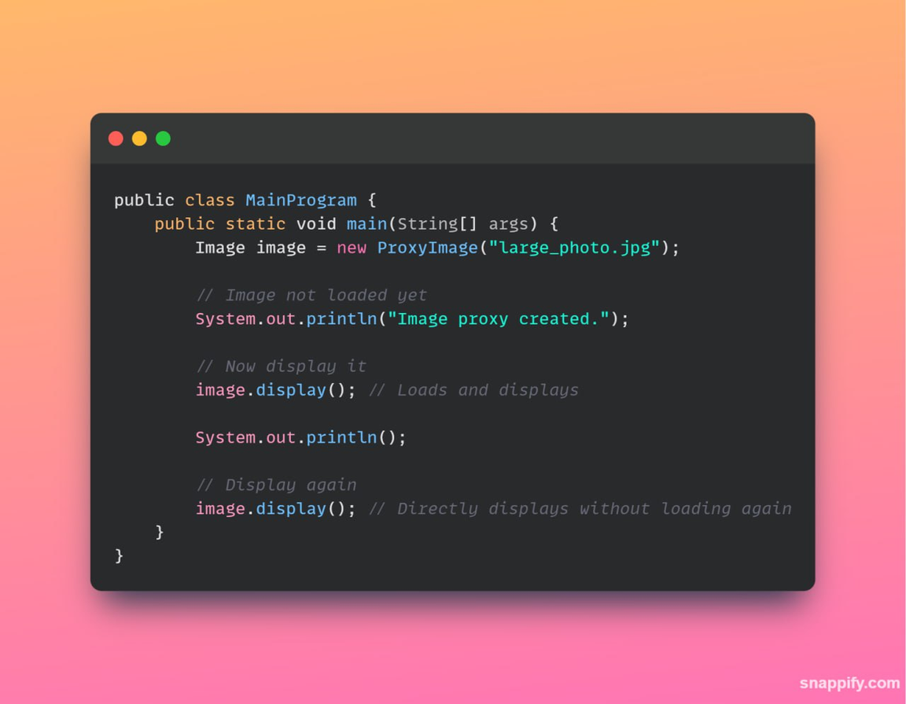
CLIENT CODE
The usage of the Proxy Design Pattern. It creates an Image object, which is actually an instance of ProxyImage.
The client invokes the display() method on the proxy.
The proxy, in turn, controls access to the real image, ensuring that it is loaded from disk only when needed.
Subsequent calls to display() use the cached image in the proxy, avoiding redundant loading and improving performance.

Slide 9
COMMON VARIATIONS
Three Flavors of Proxy
Virtual Proxy
Protection Proxy
Used for "Lazy Loading." It creates expensive objects only when they are actually needed.
Used for Security. It checks the caller’s permissions before allowing access to the RealSubject.
Remote Proxy
Used for Networking. It represents an object that exists on a different server or JVM.

Slide 10
WHY PROXY DESIGN PATTERN
Security
Performance
Adds a protective layer without modifying the original code.
Avoids memory waste by deferring the creation of "heavy" objects.
Single Responsibility
Keeps the RealSubject focused on logic while the Proxy handles "housekeeping" (logging, security, caching).

Slide 11
PROBLEMS OF PROXY DESIGN PATTERN
Increased Complexity
Performance Overhead
Adding a proxy means:
More classes
More abstraction layers
Harder code to read for beginners
Even though proxy can improve performance (like lazy loading),
it can also slow things down because:
Every request passes through proxy
Extra method calls
Extra checks (security, logging, caching)
May Hide Real Object Behavior
If proxy modifies behavior:
Developer may not know what actually happens
Unexpected side effects
Example:
Security proxy silently blocking access.

Slide 12
PROXY VS. DECORATOR
Proxy Pattern
Decorator Pattern
Focuses on Access Control. It decides IF and WHEN a client can use the object.
Focuses on Adding Behavior. It adds extra features to the object (like adding sugar to coffee).

Slide 13
CONCLUSION
The Proxy pattern is a powerful tool for optimization and security.
It promotes the Open/Closed Principle extending behavior without modifying existing code.
It is a fundamental pattern used in Java Frameworks like Spring (for AOP) and Hibernate (for Lazy Loading).

Slide 14
THANK YOU

